Slide 1
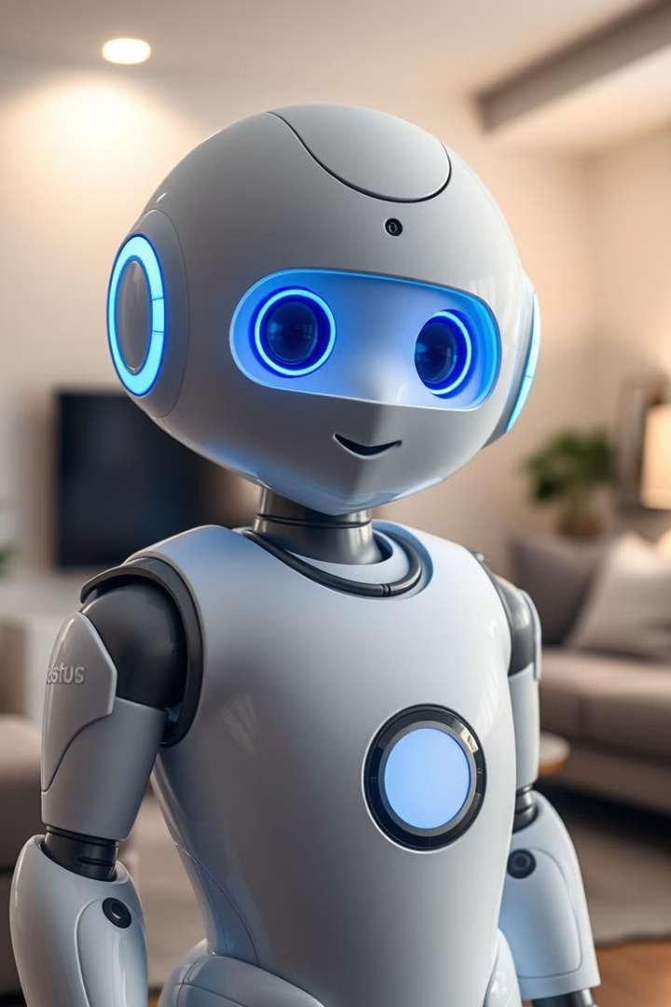



Introducing Raymax: Your Personal Healthcare Companion
Welcome to the future of personalized healthcare! Raymax, inspired by the beloved Baymax, is designed to empower individuals to take control of their well-being.
by Abdul Raffy

Slide 2
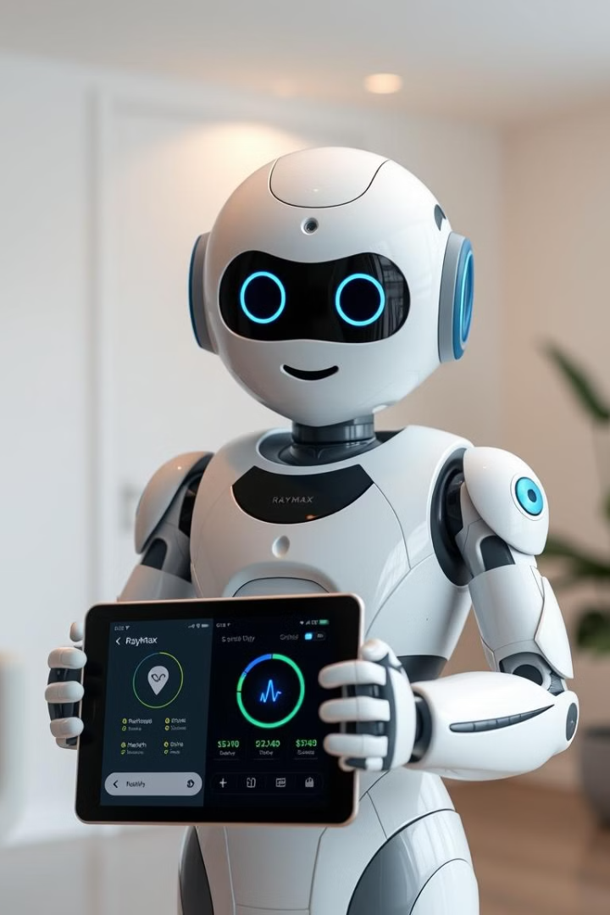
What Raymax Does
Health Monitoring
Personalized Insights
Tracks vital signs like heart rate, sleep patterns, fitness
Provides tailored advice based on your health data and goals.
Symptom Assessment
Identifies potential health issues and recommends actions.

Slide 3
Features of Raymax
Health Tracking
BMI Calculator
Water Intake Recommendation
Continuous monitoring of vital signs and activity levels.
Calorie Needs Estimation
Personalized health insights and recommendations.
Basic Symptom Checker
Heart Rate Checker
Exercise Suggestions
Sleep Tracker
Mental Health Tips
Medicine Suggestion System
Basic First Aid Guide

Slide 4
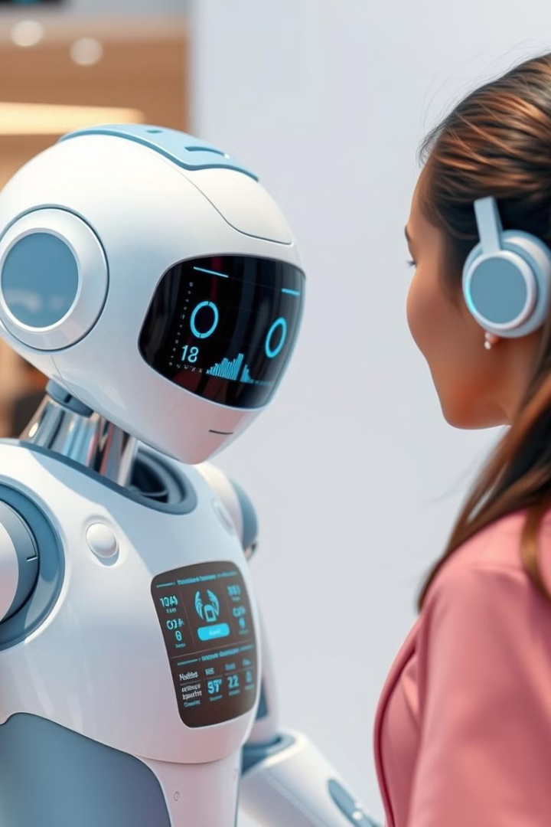





How Raymax Works
Data Collection
Collects health data through user inputs.
Data Analysis
Analyzes data to identify patterns .
Personalized Recommendations
Provides personalized recommendations and guidance.
Actionable Insights
Empowers users to make informed decisions about their health.
Core Components:
Greetings: Friendly introduction to welcome the user.
Main Menu: A list of features for users to select from.
Calculator Functions: Individual functions for health calculations like BMI, water intake, etc.
Calling Functions: Efficiently organizes and calls relevant functions based on user input.
Technology Used:
Python programming with loops, conditions, data types, and functions.
Focus on simplicity and user-friendliness.

Slide 5




Why Raymax is Unique and Efficient
1
Basic AI
2
User-Friendly Interface
3
Personalized Approach
4
Proactive Health Management

Slide 6
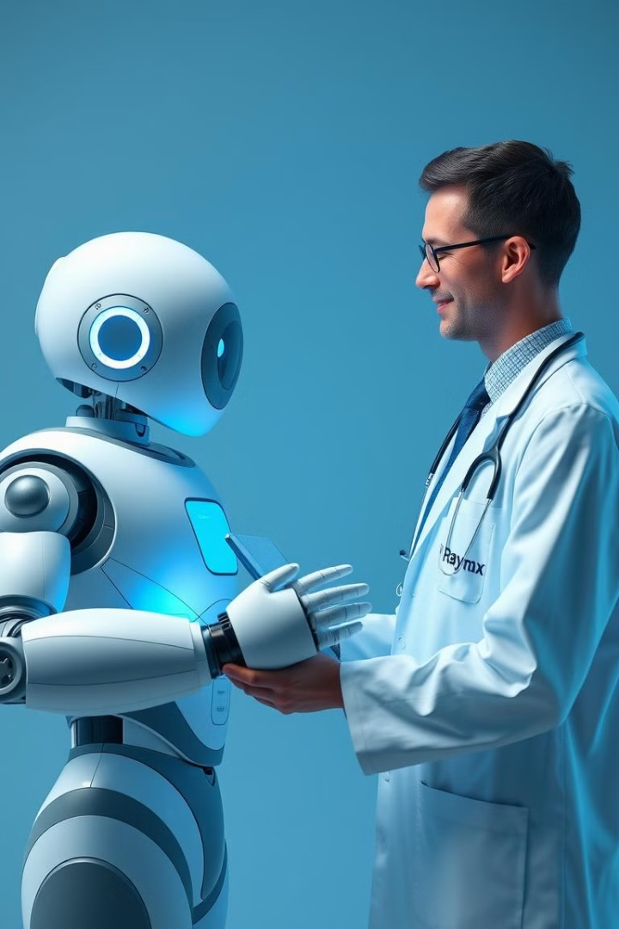



Future Goals for Raymax
GUI and Physical Transformation
Seamless interaction for user, I will develop graphical interface and then convert it to a personal Physical Robot like Baymax.
Medical Research and Emotional Support
Contribute to medical research through anonymized data collection and analysis and Raymax will be your emotional supporter too giving suggestions based on your emotions.
Learning Model
I will make it a learning model the activity or skill i will teach Raymax he will develop it either Fighting skills either defense or a developer of next Robot.

Slide 7

Thank You
I believe Raymax is a powerful tool for empowering individuals to take charge of their health and in future he will be more as your emotional supporter and a fast learner so that u dont feel alone. Thank you for your time and interest.
Special Thanks to Eman Sajid my Supervisor!
By Raffy,
AIC

